Slide 1
Matrix Chain Multiplication
Given some matrices to multiply, determine the best order to multiply them so you minimize the number of single element multiplications.
  i.e. Determine the way the matrices are parenthesized.
First off, it should be noted that matrix multiplication is associative, but not commutative. But since it is associative, we always have:
((AB)(CD)) = (A(B(CD))), or any other grouping as long as the matrices are in the same consecutive order.
BUT NOT: ((AB)(CD)) = ((BA)(DC))

Slide 2
Matrix Chain Multiplication
It may appear that the amount of work done won’t change if you change the parenthesization of the expression, but we can prove that is not the case!
Let us use the following example:
  Let A be a 2x10 matrix
  Let B be a 10x50 matrix
  Let C be a 50x20 matrix
But FIRST, let’s review some matrix multiplication rules…

Slide 3
Matrix Chain Multiplication
Let’s get back to our example: We will show that the way we group matrices when multiplying A, B, C matters:
  Let A be a 2x10 matrix
  Let B be a 10x50 matrix
  Let C be a 50x20 matrix
Consider computing A(BC):
  # multiplications for (BC) = 10x50x20 = 10000, creating a 10x20 answer matrix
  # multiplications for A(BC) = 2x10x20 = 400
  Total multiplications = 10000 + 400 = 10400.
Consider computing (AB)C:
  # multiplications for (AB) = 2x10x50 = 1000, creating a 2x50 answer matrix
  # multiplications for (AB)C = 2x50x20 = 2000,
  Total multiplications = 1000 + 2000 = 3000
Notes:
Consider computing A(BC)
We multiply BC first, how many element multiplications are required?
What are the dimensions of our resulting matrix?
Then we multiply A(BC)
How many element multiplications are required?
What are the TOTAL element multiplications??
Consider computing (AB)C
We multiply AB first, how many element multiplications are required?
What are the dimensions of our resulting matrix?
Then we multiply (AB)C
How many element multiplications are required?
What are the TOTAL element multiplications??
IS THERE A DIFFERENCE BETWEEN THE NUMBER OF MULTIPLICATIONS necessary for the different groupings??

Slide 4
Matrix Chain Multiplication
Thus, our goal today is:
Given a chain of matrices to multiply, determine the fewest number of multiplications necessary to compute the product.

Slide 5
Matrix Chain Multiplication
Formal Definition of the problem:
  Let A = A₁• A₂• ... A_{n}
  Let M_{i,j} denote the minimal number of multiplications necessary to find the product:
    A_{i}• A_{i+1}• ... A_{j}.
  And let p_{i-1}xp_{i} denote the dimensions of matrix A_{i}.
We must attempt to determine the minimal number of multiplications necessary(m_{1,n}) to find A,
  assuming that we simply do each single matrix multiplication in the standard method.

Slide 6
Matrix Chain Multiplication
The key to solving this problem is noticing the sub-problem optimality condition:
  If a particular parenthesization of the whole product is optimal, then any sub-parenthesization in that product is optimal as well.
Say What?
  If (A (B ((CD) (EF)) ) ) is optimal
  Then (B ((CD) (EF)) ) is optimal as well
  Proof on the next slide…

Slide 7
Matrix Chain Multiplication
Assume that we are calculating ABCDEF and that the following parenthesization is optimal:
    (A (B ((CD) (EF)) ) )
  Then it is necessarily the case that
    (B ((CD) (EF)) )
  is the optimal parenthesization of BCDEF.
Why is this?
  Because if it wasn't, and say ( ((BC) (DE)) F) was better, then it would also follow that
    (A ( ((BC) (DE)) F) ) was better than
    (A (B ((CD) (EF)) ) ),

Slide 8
Matrix Chain Multiplication
Our final multiplication will ALWAYS be of the form
  (A₁• A₂• ... A_{k}) • (A_{k+1}• A_{k+2}• ... A_{n})
In essence, there is exactly one value of k for which we should "split" our work into two separate cases so that we get an optimal result.
  Here is a list of the cases to choose from:
  (A₁) • (A₂• A₃• ... A_{n})
  (A₁• A₂) • (A₃• A₄• ... A_{n})
  (A₁• A₂•A₃) • (A₄• A₅• ... A_{n})
  ...
  (A₁• A₂• ... A_{n-2}) • (A_{n-1}• A_{n})
  (A₁• A₂• ... A_{n-1}) • (A_{n})
Basically, count the number of multiplications in each of these choices and pick the minimum.
  One other point to notice is that you have to account for the minimum number of multiplications in each of the two products.

Slide 9
Matrix Chain Multiplication
Consider the case multiplying these 4 matrices:
  A: 2x4
  B: 4x2
  C: 2x3
  D: 3x1
1. (A)(BCD) - This is a 2x4 multiplied by a 4x1,
  so 2x4x1 = 8 multiplications, plus whatever work it will take to multiply (BCD).
2. (AB)(CD) - This is a 2x2 multiplied by a 2x1,
  so 2x2x1 = 4 multiplications, plus whatever work it will take to multiply (AB) and (CD).
3. (ABC)(D) - This is a 2x3 multiplied by a 3x1,
  so 2x3x1 = 6 multiplications, plus whatever work it will take to multiply (ABC).

Slide 10
Matrix Chain Multiplication
Our recursive formula:
  M_{i,j} = min value of M_{i,k} + M_{k+1,j} + p_{i-1}p_{k}p_{j}, over all valid values of k.
Now let’s turn this recursive formula into a dynamic programming solution
  Which sub-problems are necessary to solve first?
  Clearly it's necessary to solve the smaller problems before the larger ones.
    In particular, we need to know m_{i,i+1}, the number of multiplications to multiply any adjacent pair of matrices before we move onto larger tasks.
    Similarly, the next task we want to solve is finding all the values of the form m_{i,i+2}, then m_{i,i+3}, etc.

Slide 11
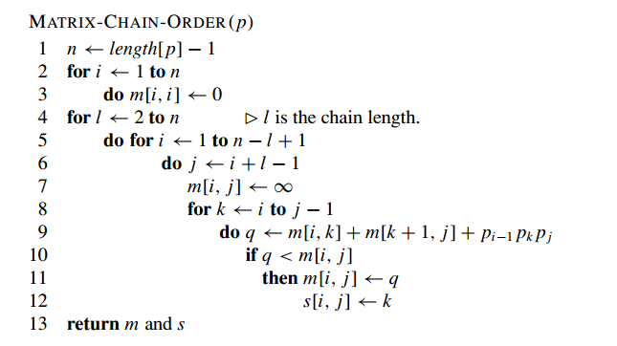
Matrix Chain Multiplication
Basically, we’re checking different places to “split” our matrices by checking different values of k and seeing if they improve our current minimum value.

Slide 12
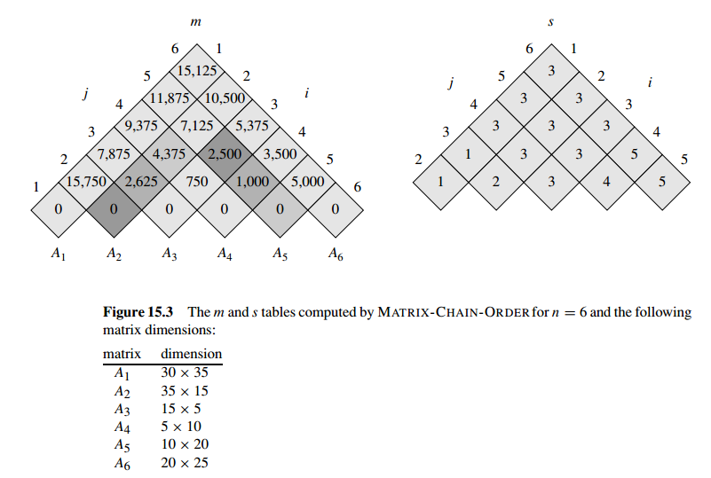

Slide 13
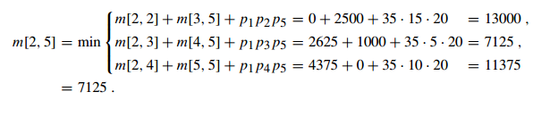
A1 = 30 X 35
A2 = 35 X 15
A3 = 15 X 05
A4 = 05 X 10
A5 = 10 X 20
A6 = 20 X 25
m[i,j] = m[i,k] + m[k+1,j] + P_{i-1}*P_{k}*P_{j}

